Slide 1
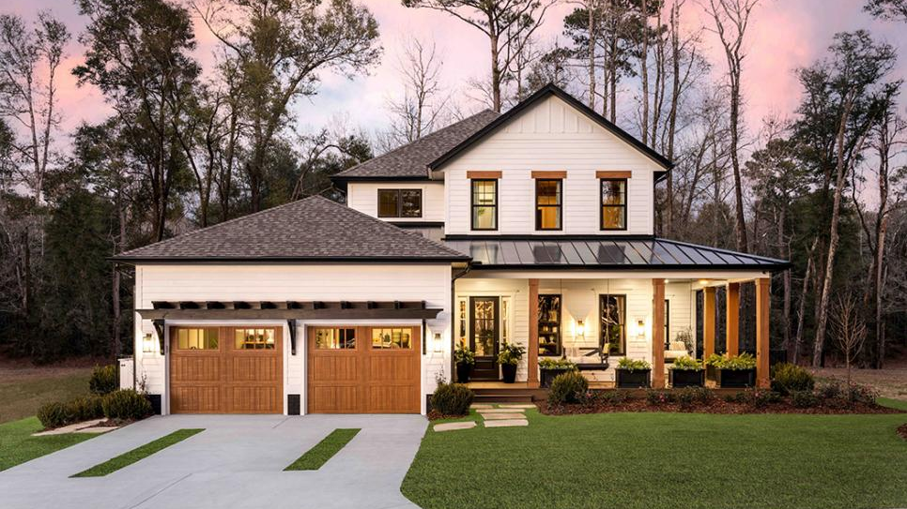
Ames Housing
Erin Saunders, Nolan Arendt, and Robert Ransom​​

Slide 2
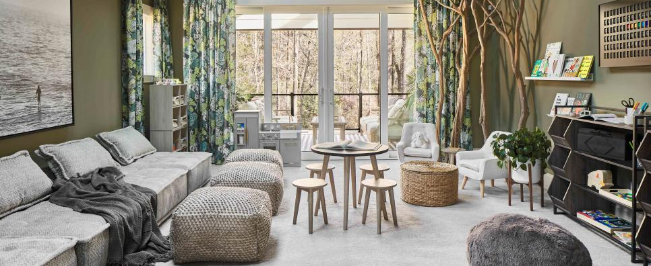
background
Ames, Iowa housing dataset broken down by house features for 80 variables ranging from lot size and square footage, to siding material and patio construction. Overall, approximately 234,000 individual features could be assessed to identify and model the most impactful variables in the Ames Housing Market.

Slide 3
Executive Summary
The Ames, Iowa housing dataset provides valuable information on important house features and the sale price that can help determine the return on investment (ROI) for different housing features in the Ames Housing Market. These features include lot size, year built, neighborhood, exterior quality, basement quality, heating quality, kitchen quality, garage quality, deck square footage, and sale price. Analyzing these features can help inform decisions related to maximizing ROI and guide strategic investments in the housing market. By using this dataset to identify the most impactful features, individuals can make more informed decisions related to buying, selling, or investing in real estate in Ames, Iowa to maximize their ROI.

Slide 4




Project Roadmap
Data selection
Data cleansing
Data visualization
Exploratory Data analysis
Identifying and selecting the most applicable data to support our business questions
Various techniques to ensure that the data is accurate, complete, and ready for analysis
Techniques used to identify patterns, trends, and relationships that may not be immediately apparent from the raw data
Examining and summarizing data to gain actionable insights on the housing dataset

Slide 5
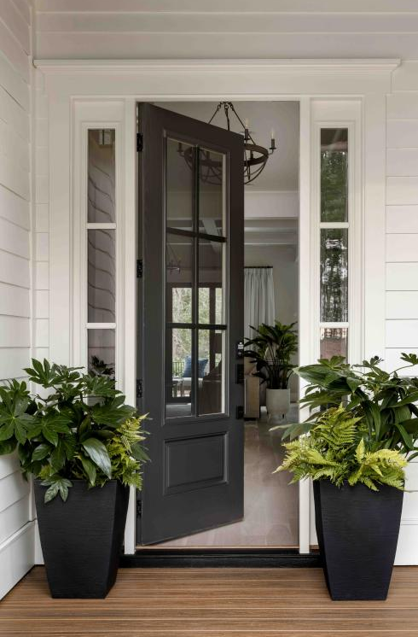
Methodology
Data cleansing
To prepare the Ames, Iowa housing dataset for analysis, three primary cleaning techniques were employed: Dummification, Combination, and Categorization.
Dummification was used to convert string variables into binary variables
Combination was used to combine available square footage variables to calculate the total square footage impact
Categorization was used to determine the significance of several external attributes
These cleaning techniques were necessary to ensure that the data was accurately represented and ready for analysis.
Notes:
Removed outliers
Removed duplex/multi family homes

Slide 6
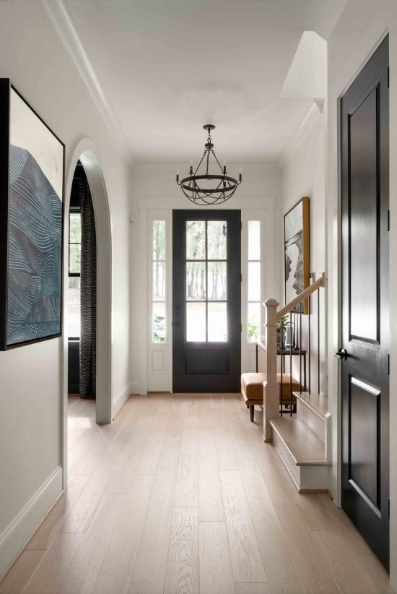
Variable selection
The goal of variable selection is to identify the variables that have the most significant impact on the sale price of a property.
Sub Class
Neighborhood
Year Built
Exterior Quality
Basement Quality
Heating Quality and Condition
Kitchen Quality
Garage Quality
Lot Area
First Floor Square Feet
Second Floor Square Feet
Full Bath
Half Bath
Wood Deck Square Feet
Sales Price
Notes:
Variable selection is a critical step in analyzing the Ames, Iowa housing dataset. The goal of variable selection is to identify the variables that have the most significant impact on the outcome variable (in this case, the sale price of a property). The following are some of the primary techniques used in variable selection:
Correlation analysis: Correlation analysis is used to identify variables that have a strong correlation with the outcome variable. Variables with a high correlation coefficient are considered to have a significant impact on the outcome variable.
Feature importance ranking: Feature importance ranking involves ranking variables based on their importance in predicting the outcome variable. This can be done using machine learning techniques such as decision trees or random forests.
Stepwise regression: Stepwise regression is a statistical technique used to identify the variables that have the most significant impact on the outcome variable. This technique involves adding or removing variables from the model until the most significant variables are identified.
Domain knowledge: Domain knowledge can be used to identify variables that are likely to have a significant impact on the outcome variable. For example, external factors such as the neighborhood or school district are likely to have a significant impact on the sale price of a property.
Overall, variable selection is an essential step in analyzing the Ames, Iowa housing dataset, and the techniques used can provide valuable insights into the factors that impact the value of a property in the Ames Housing Market.

Slide 7
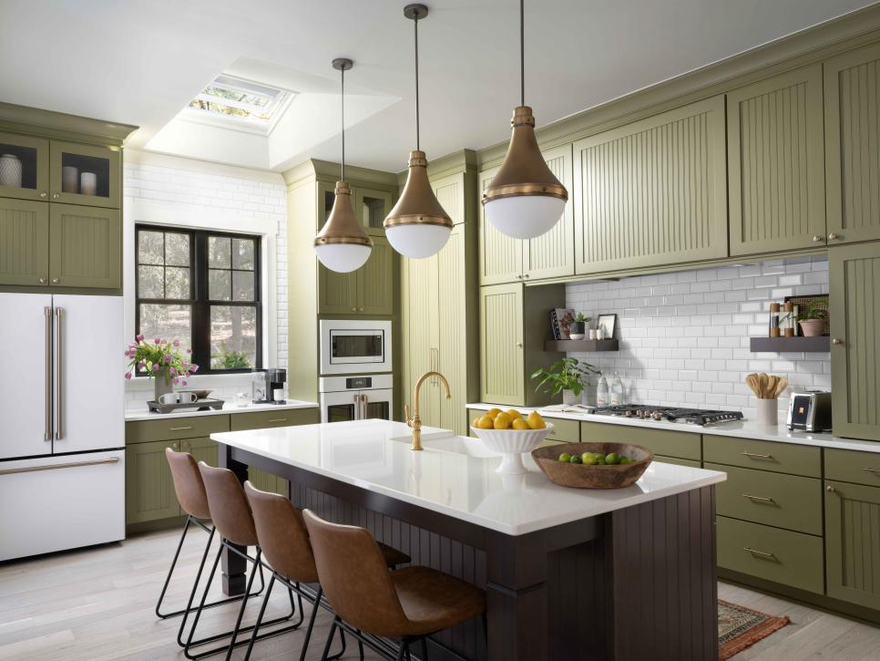
Results and Business Answers

Slide 8
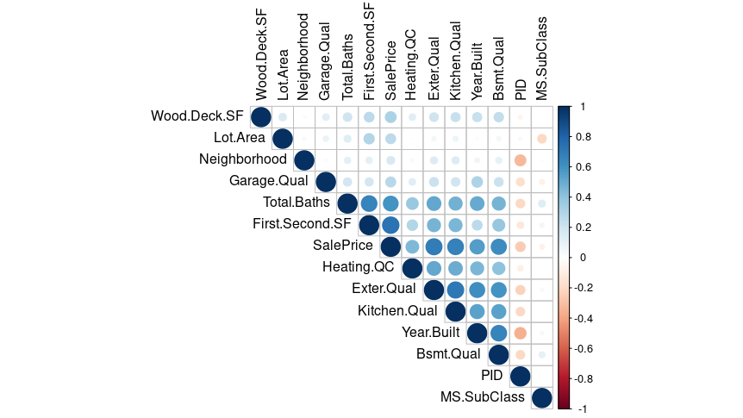
Variables with greatest impact on Sale Price
The correlation matrix helps us identify the most important variables that impact the value of a property in the Ames Housing Market. By using this matrix, we can narrow down from a larger selection of variables to the top 14 that are strongly correlated with Sale Price. This information can be used to guide investment decisions and maximize ROI in the real estate market.
Notes:
Business question # 1: What variables have the greatest impact on sale price?
The correlation matrix provides an impressive visual representation of the direction and strength of the relationship between multiple variables. Using this matrix, most impactful variables were further focused from the original selection of 16 to the 7 that represent the greatest correlation with SalePrice. Surprisingly, Neighborhood and Lot.Area had a weak correlation with SalePrice, which could be expected in a larger city where certain neighborhoods or larger plots are at a premium. Conversely, Bsmt.Qual (which references basement height, not finish) had one of the strongest correlations. After preliminary research and personal experience, knowing that Ames, IA is a prime location for tornado activity helps to explain that correlation, where smaller basements may not accommodate individuals or families, or incur increased cost to shore up resilience with a relative level of comfort during storms.

Slide 9
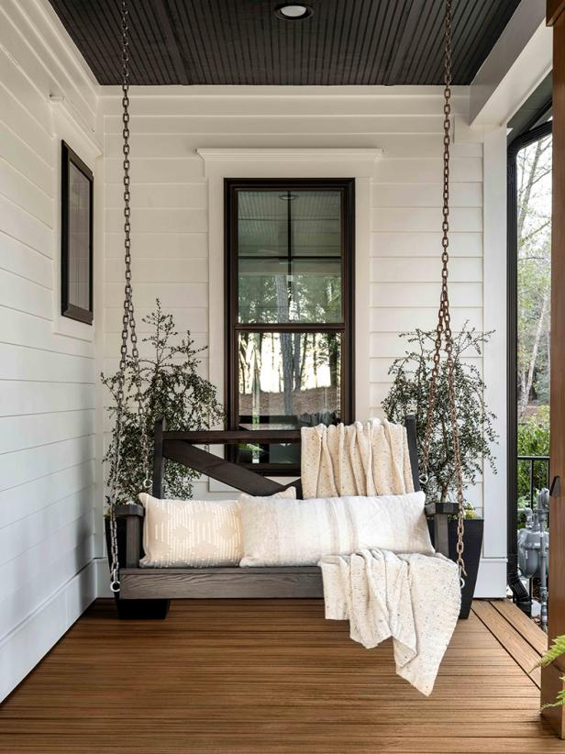
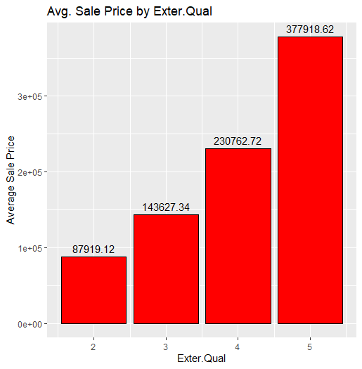
What improvements can be made with the best roi?
Each variable quality category was analyzed against the average sale price for listings at that level.
For example, upgrading exterior quality from category 3 to 4 could potentially increase resale value by ~$90K.
Exterior Quality | Avg Sale Price
2 | $ 87,919​
3​ | $143,627​
4​ | $230,763​
5​ | $377,919​
Final Project
Notes:
Each variable quality category was analyzed against the average SalePrice for listings at that level.
For example, upgrading Exterior Quality from category 3 to 4 could potentially increase resale value by ~$90K.
Each variable was analyzed in this manner to provide buyers with areas to target for potential improvements or consider when negotiating purchase price.
Upgrading from Good to Excellent in Exterior Quality provides the greatest impact on average sale price (~$147K).
Upgrading from Typical to Good may be more attainable depending on available funds and investment capability (~$90K).

Slide 10
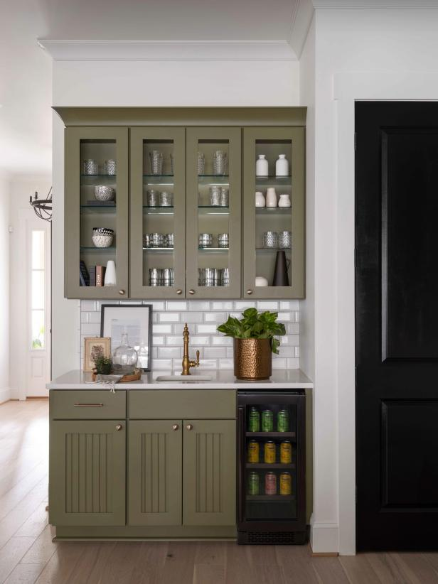
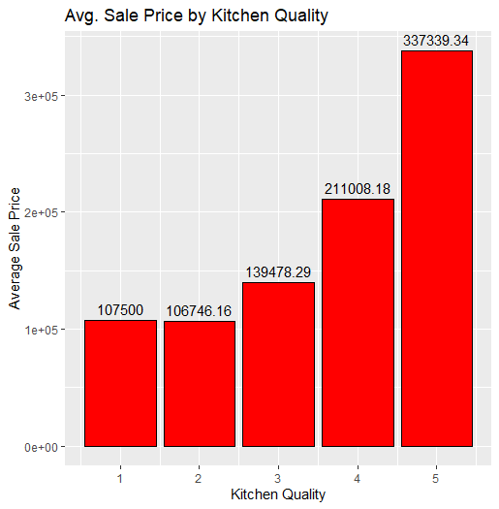
Kitchen Quality
Kitchen quality has a significant impact on sale price, with higher-end kitchens improving average sale price by ~$70-200K.
For first-time homebuyers, it is recommended to purchase a property with a Typical Kitchen Quality and upgrade to Good quality for maximum ROI.
Notes:
Kitchen Quality has a significant impact on sale price, with higher-end kitchens improving average sale price by ~$70-200K.
Upgrading from Poor to Fair in Kitchen Quality does not appear to impact average sale price.
For first-time homebuyers, it is recommended to purchase a property with a Typical Kitchen Quality and upgrade to Good quality for maximum ROI.

Slide 11
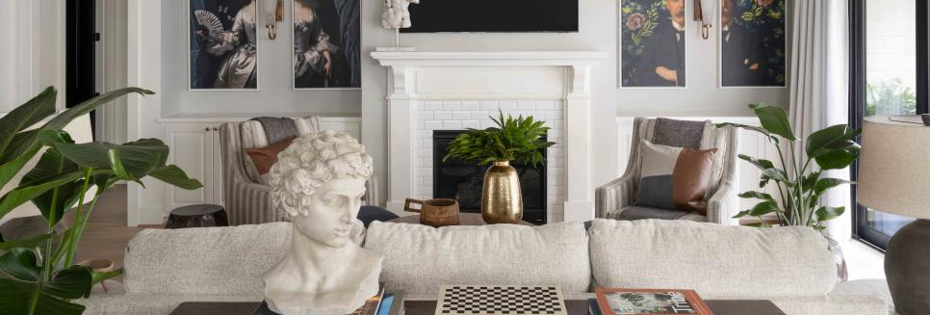
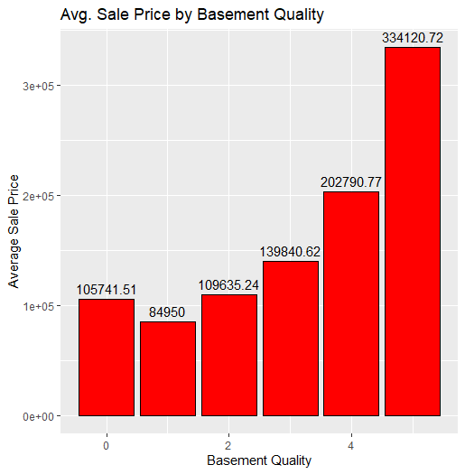
Basement Quality
Modifying basement height is a difficult recommendation as it would likely require architectural modifications and could incur additional costs.
Based on the year of the house, modifying foundation type aspects could expose larger structural issues or requirements that may outweigh the value gained.

Slide 12
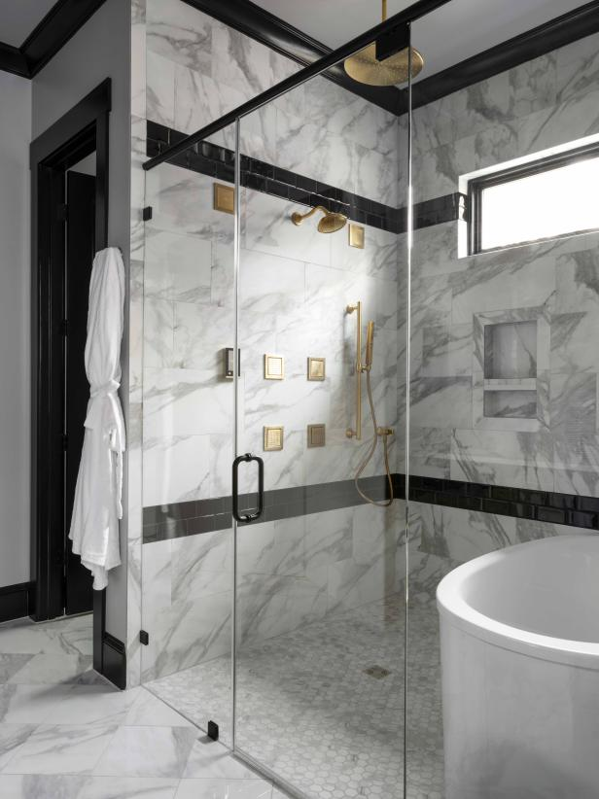
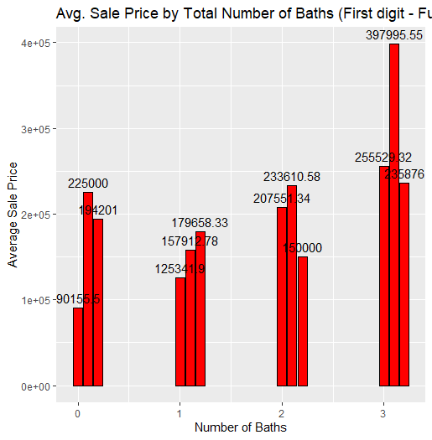
On average, adding an additional half bath adds ~$25K if the total number of half baths is below 2.
Houses with two half baths and more full baths tended to reduce in price rather than increase with the number of baths.
The largest impact seen was from three full baths to three full baths and one-half bath.
Total Baths (Full).(Half) | Average Sale Price
0 | $90, 156
0.1 | $225, 000
0.2 | $194, 201
1 | $125, 342
1.1 | $157, 913
1.2 | $179, 658
2 | $207, 551
2.1 | $233, 611
2.2 | $150, 000
3 | $255, 529
3.1 | $397, 996
3.2 | $235, 876
Total Baths
Notes:
On average, adding an additional half bath adds ~$25K if the total number of half baths is below 2.
Houses with two half baths and more full baths tended to reduce in price rather than increase with the number of baths.
The largest impact seen was from three full baths to three full baths and one half bath.

Slide 13
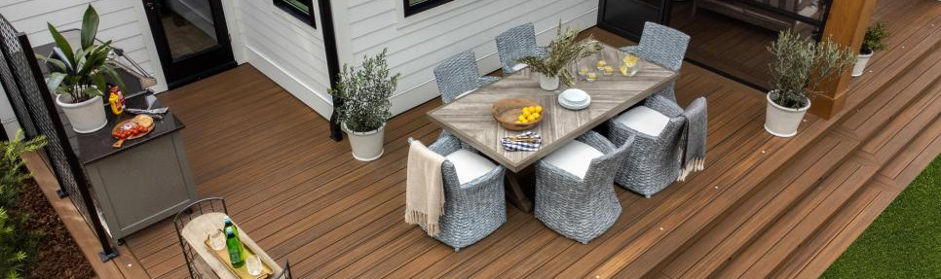
Neighborhood
Neighborhood is a variable that cannot be upgraded after initial purchase unless the house is physically moved, which comes at great expense.
Lower cost neighborhoods may provide larger budgeting for upgrades, but additional investigation is required to understand the granular impacts of individual options on specific neighborhoods.

Slide 14
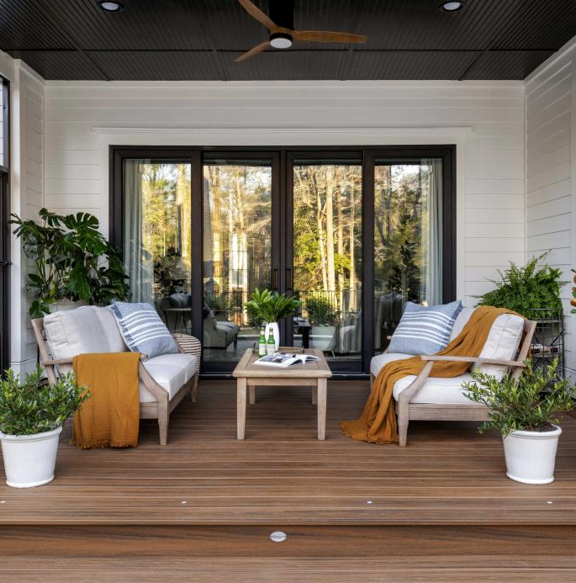
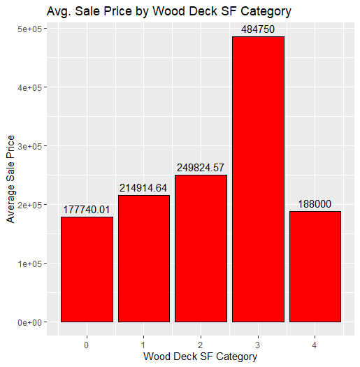
Wood Deck
Outdoor gathering spaces between 500 and 750 square feet have the greatest impact when upgrading from category 2 to 3.
Larger plots in less urbanized neighborhoods would benefit the most from installation or improvement of an outdoor space.

Slide 15
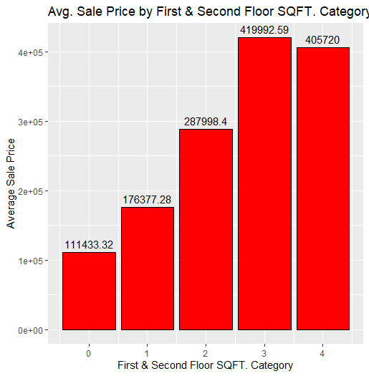
First/Second Floor Square Footage (Categorized)
Expanding square footage is challenging and costly as it usually requires modifying the foundation or converting non-living spaces. Homeowners must carefully weigh the benefits of additional living area against the costs and trade-offs.
1st/2nd Sq Ft | Average Sale Price
0 (No 2nd Floor) | $111, 433
1 (1000-1999 sf) | $176, 377
2 (2000-2999 sf) | $287, 998
3 (3000-3999 sf) | $419, 993
4 (>= 4000 sf) | $750, 000

Slide 16
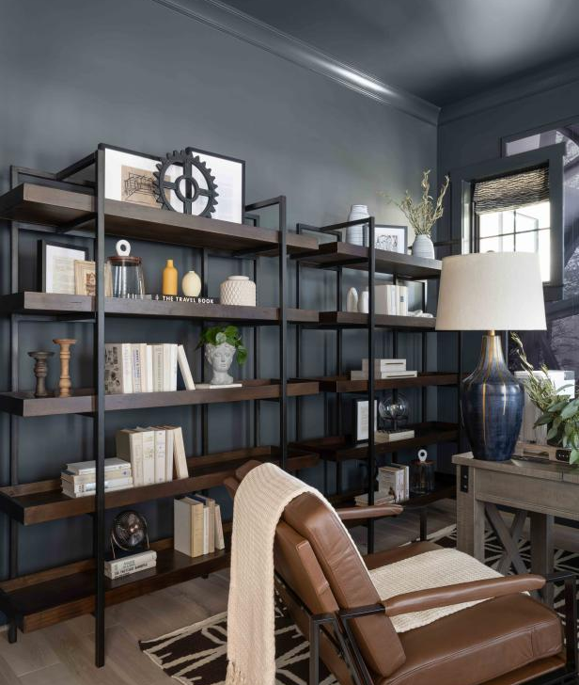
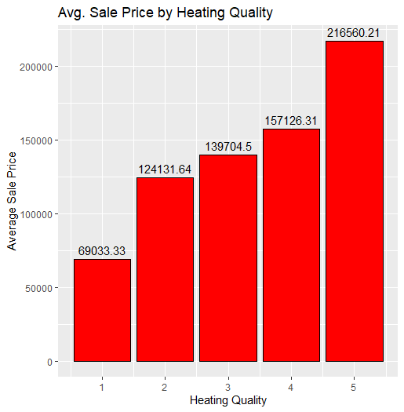
HEATING QUALITY
Heating quality has the lowest impact on sale price among the selected variables. Upgrading to a higher quality system may not be worth the cost if the current system is adequate. Upgrading from category 1 to 2 has a similar impact as upgrading from category 4 to 5.

Slide 17
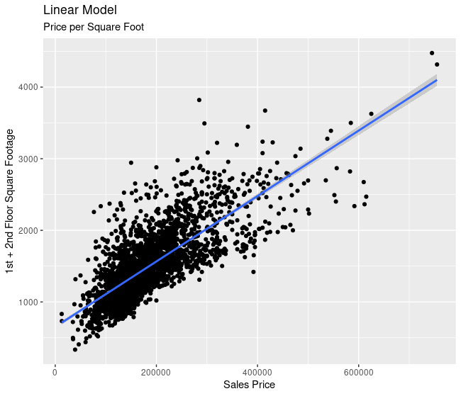
HOW DOES Square Footage IMPACT SALE PRICE?
Square footage has a linear relationship with Sale Price, as Square footage increases, Sale Price increases at a similar rate.
Primary concentration of sales occurred for houses below 2500 square feet, between $100K and $300K.
Square footage of the home is fixed, so additional value in the property must be developed with internal and external updates to categorically raise the worth of individual components.

Slide 18
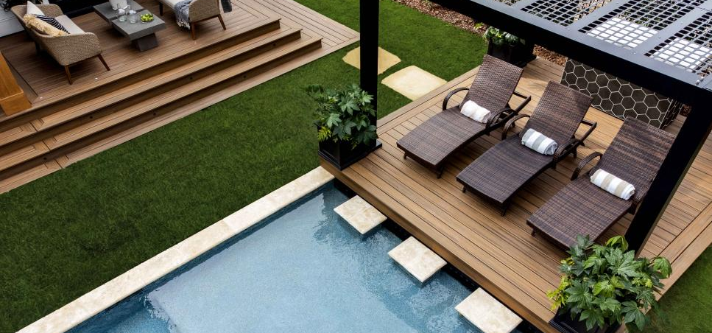
What external modifications can be made with the greatest ROI?
Improving external quality through upgrades such as installing new paneling or replacing weather-beaten siding can lead to a significant increase in Sale Price. Exterior Quality is categorized from Poor to Excellent, with the greatest impact on average sale price seen when upgrading from Good to Excellent ($147K). Upgrading from Typical to Good is a more attainable option for those with limited funds, resulting in an increase of approximately $90K in Sale Price.

Slide 19

What Internal modifications can be made with the greatest ROI?
Kitchen Quality has the highest impact on Sale Price among internal systems.
Upgrading Kitchen Quality yields a higher return compared to Basement or Heating Quality.
On average, each increase in Kitchen Quality category results in a $40-50K increase in Sale Price.

Slide 20
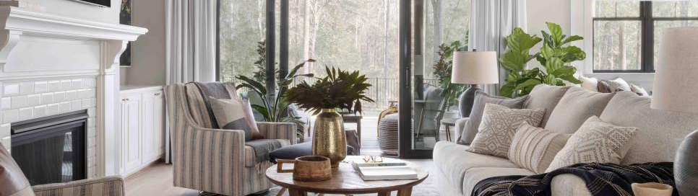
Of the variables, what has the least impact on Sale price?
Heating Quality has the least impact on Sale Price as categories increase according to the developed linear regression model.
The coefficient value for Heating Quality is only $1,774, indicating it does not provide adequate return on investment for middle-tier categories.
Upgrading Heating Quality only provides returns when upgrading from Poor to Fair, or from Good to Excellent.

Slide 21
For various available budgets, what recommendations could be made for current house configuration and potential improvements for greatest ROI?
Prediction testing involved modeling an ideal home purchase for a first-time buyer with a $350K budget
Selected variables for analysis were Wood Deck category, Exterior Quality, Heating Quality, Square Footage, Basement Quality, and Kitchen Quality
Predictive analysis allows for changes in the model to determine future returns
Expected ROI for the initial purchase price of ~$350K predicts a return value of $156,597, approximately 150% growth in Sale Price
Predicted Purchase Categories | Predicted Resale Categories | Final Change and Value
Wood Deck SF: 2 | Wood Deck SF: 3 | +1
Exterior Quality: 4 | Exterior Quality: 5 | +1
Heating Quality: 1 | Heating Quality: 2 | +1
1st/2nd SF Category: 3 | 1st/2nd SF Category: 4 | +1
Basement Quality: 4 | Basement Quality: 5 | +1
Kitchen Quality: 4 | Kitchen Quality: 5 | +1
Est. Price: $360, 603 | Est. Sale Price: $517, 200 | +$156, 597

Slide 22
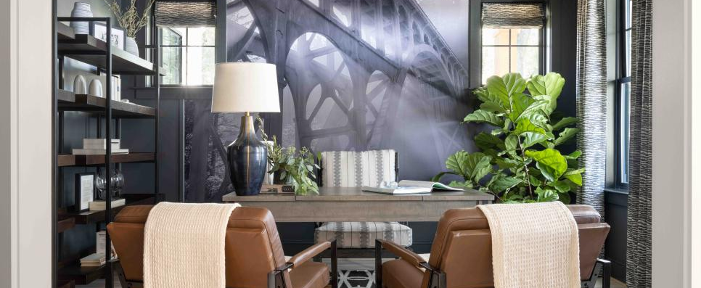
summary
After review of the Ames Housing Market, our findings revealed that kitchen quality had the most significant influence on sale price, with an average increase of $40-50K per quality category. Exterior quality also had a considerable impact, with an upgrade from Good to Excellent resulting in an average increase of $147K in sale price. We also noted the linear relationship between square footage and sale price, and how heating quality had the lowest effect on sale price. Additionally, we considered factors like neighborhood, outdoor space, and basement height when making upgrades, and the potential ROI for different upgrades based on their initial quality. Lastly, we presented the results of our predictive analysis, which showed a potential return on investment of around 150% for an initial home purchase price of $350K, based on changes to selected features.

Slide 23
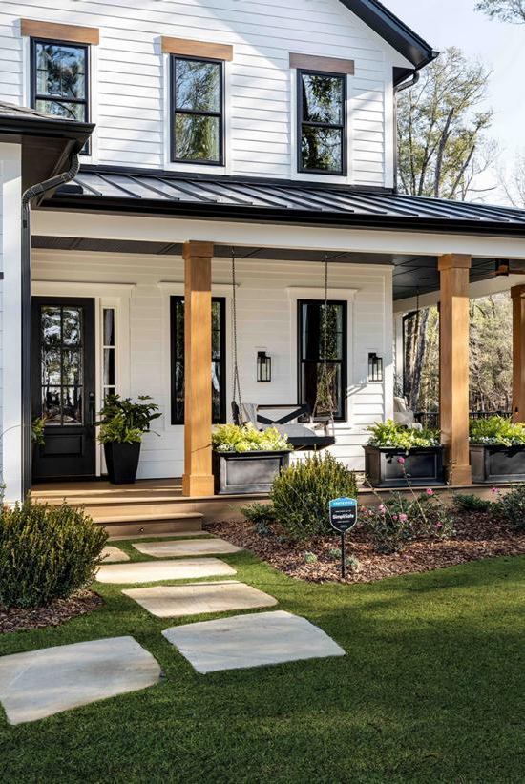
Questions?

